Slide 1


RETAIL SALES PREDICTION ANALYSIS
GAYATHRI GOPALAN
Professor:
NILOOFAR ZARIFI

Slide 2
GOAL OF ANALYSIS
Retail Sales Analysis:
Analyzing everything from inventory to sales
- To effectively track and boost sales
- Perform better in the market
- Provide insights of buying behavior, forecast and plan for future
- Optimize supply chain
-Gaining more profits
-To provide customers what they need most

Slide 3
Understanding the data of Retail Sales of the Company- Exploratory Data Analysis and Validating issues with the dataset
Year
Product line
Product type
Product
Order method type
Retailer country
Revenue, planed revenue
Product Cost-
Quantity
Unit cost, Unit Price, Unit Sale Price
Dealing with:
Missing values
Outliers
Data Capture Error
Cleaning the data! 70% missing data from column, so delete them

Slide 4
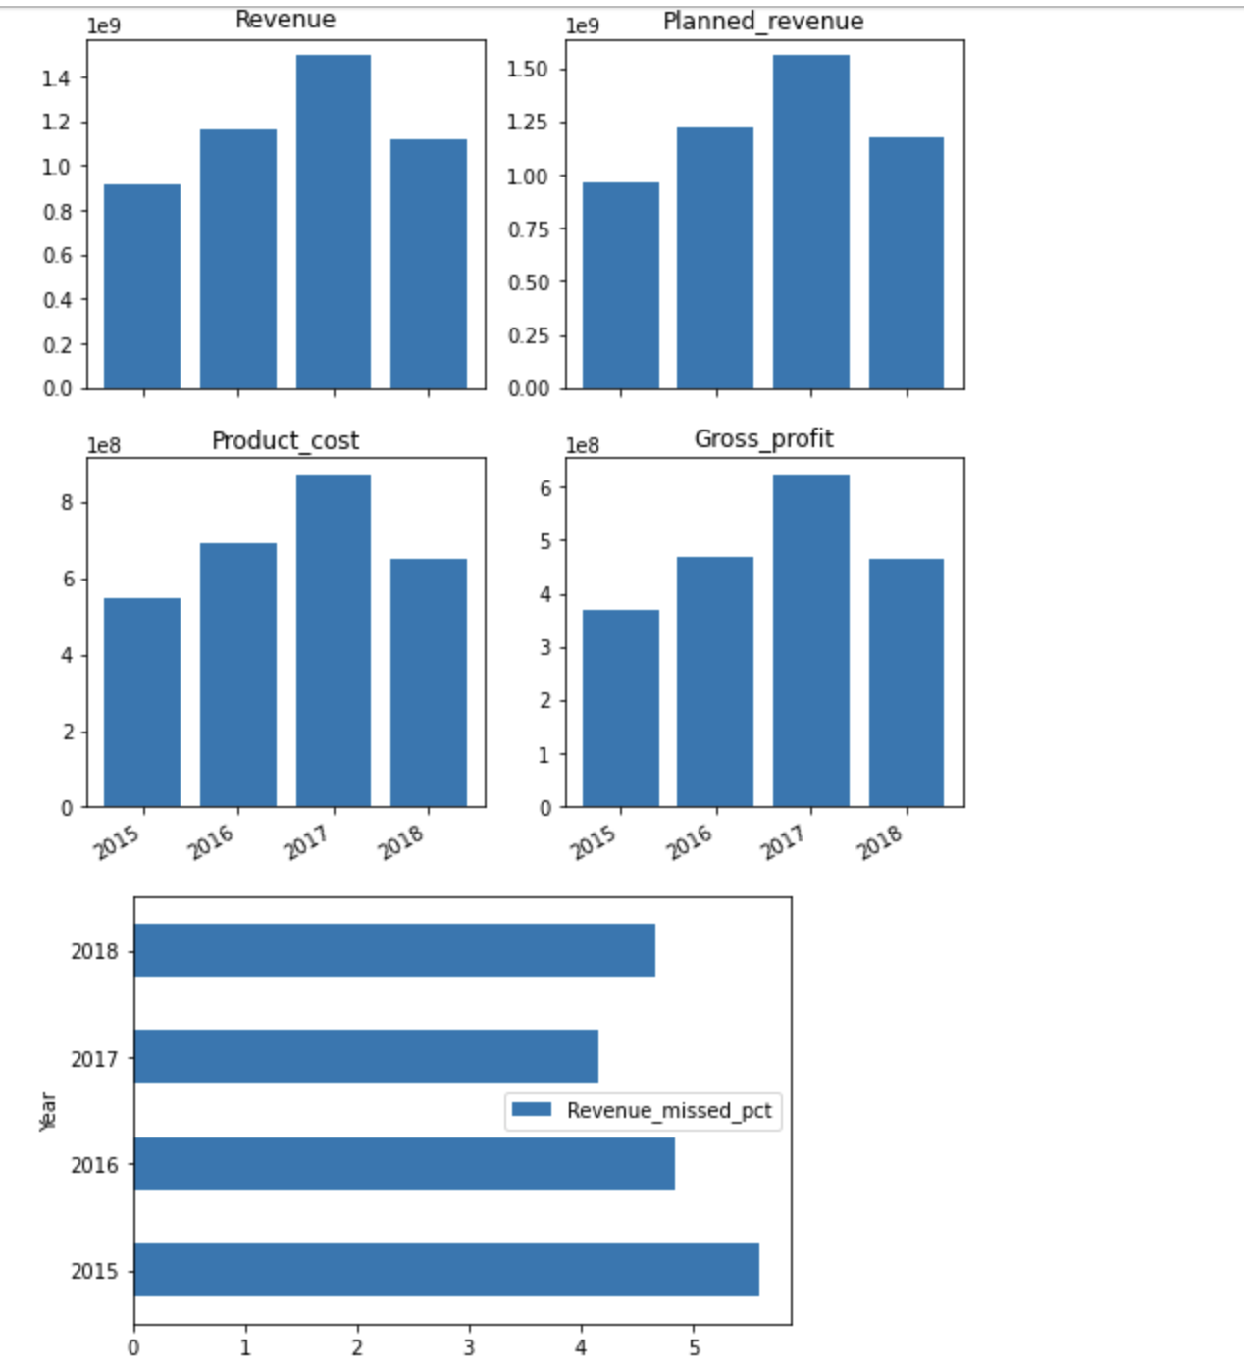
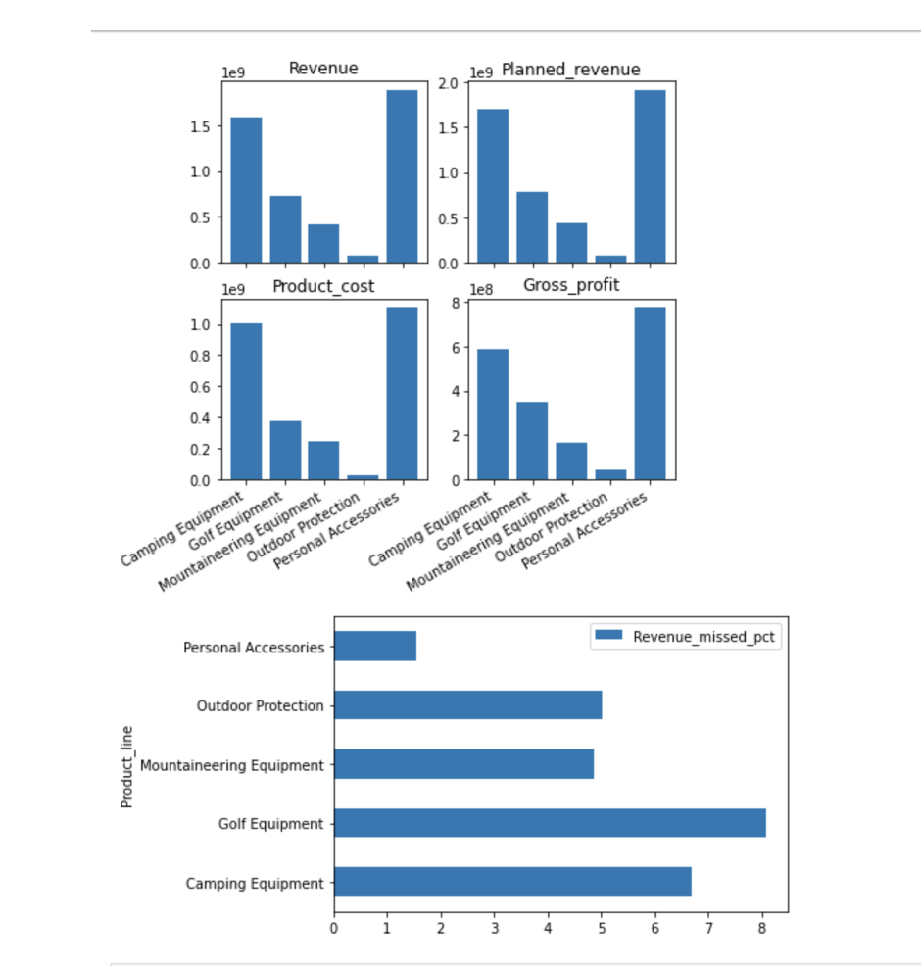
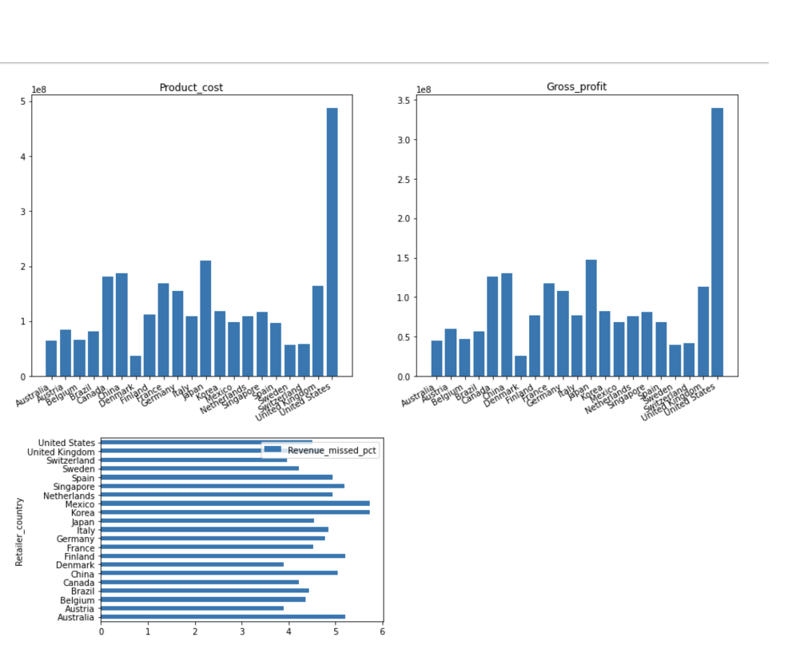
Interesting Patterns and Findings- Insights
Year, Product Line and Retailer Country

Slide 5
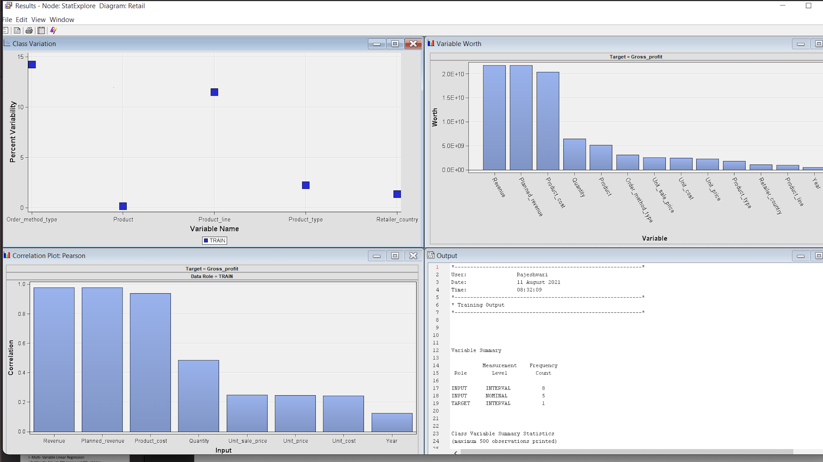
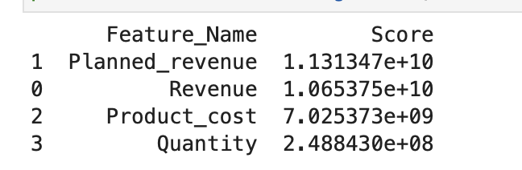
Descriptive Analysis- Feature Selection
This step can be used for retailers to increase sales by better understanding purchasing patterns.
Feature Selection
Hugely impacts performance of model.
reduces overfitting
improves accuracy
reduces training time
Top three features that are selected by the algorithm does not have any outliers.
However Quantity is not a linearly increasing metrics with Gross_Profit

Slide 6
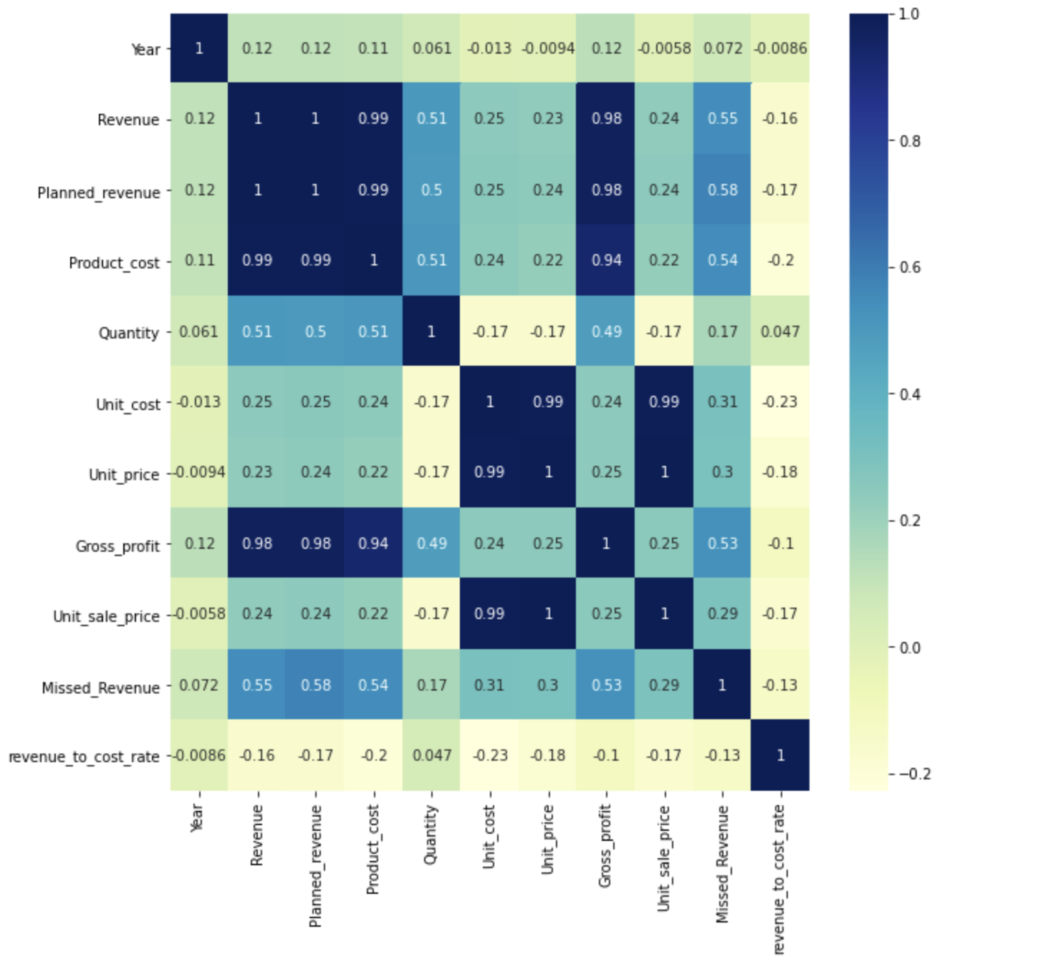
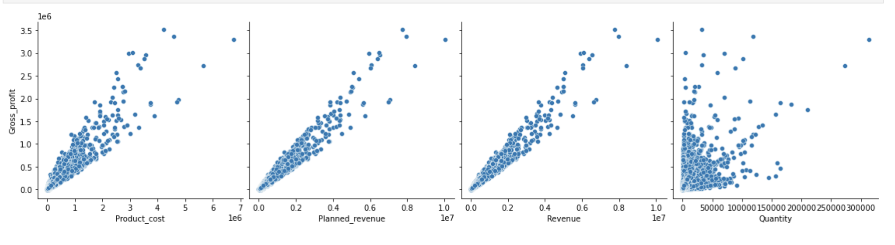
Heatmap and ScatterPlot

Slide 7
Training and Testing- How validation helps overfitting
Partition the data into 80% training and 20% validation.
Cross-validation is a powerful preventative measure against overfitting
Run more splits. Then you are sure that the algorithm is not overfitting, if every test score has a high accuracy you are doing good.

Slide 8
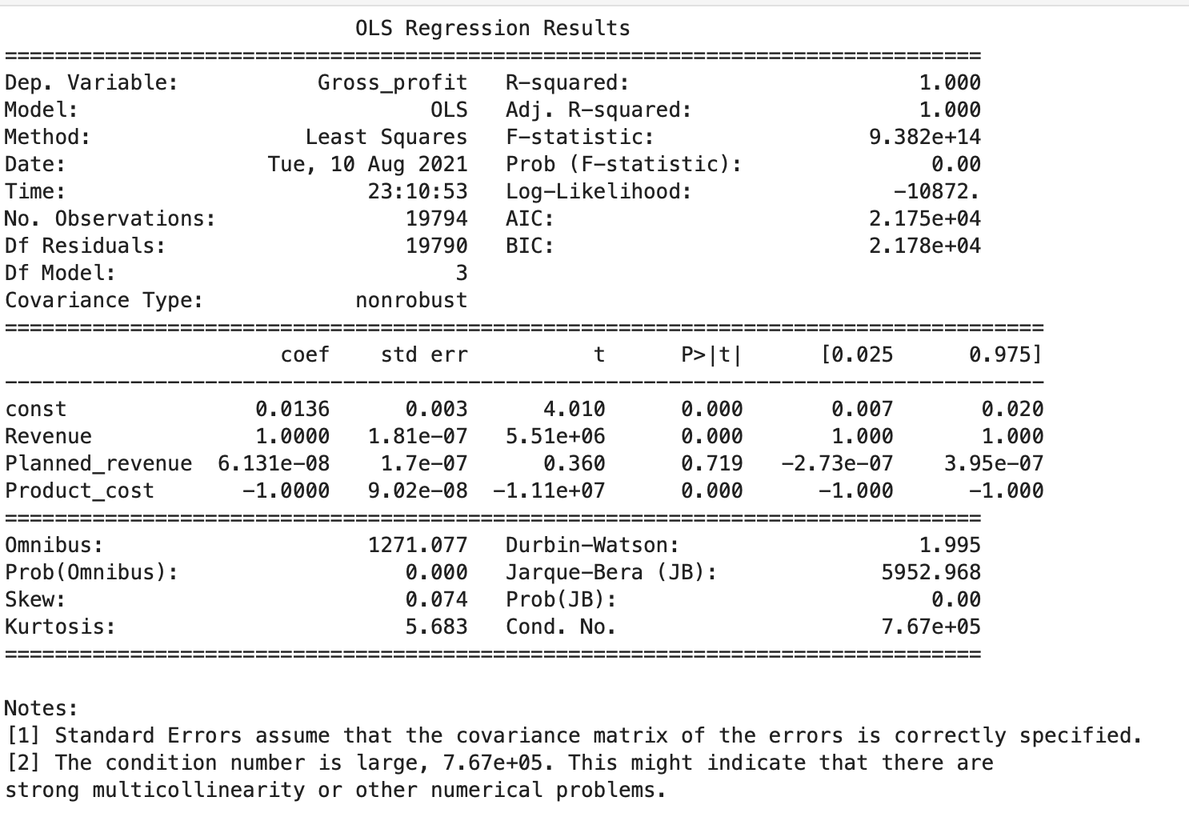
Building Predictive ML models based on insights & patterns: I- Multi- Variable Linear Regression
Coefficient Interpretation:
Revenue
Planned_revenue
Product_cost
R - squared is 1:
This is a perfect R-squared value, which implies that independent variables and dependent variables are having a strong correlation.
F statistic has a very low p value (practically low)
Meaning that the model fit is statistically significant, and the explained variance isn't purely by chance.

Slide 9
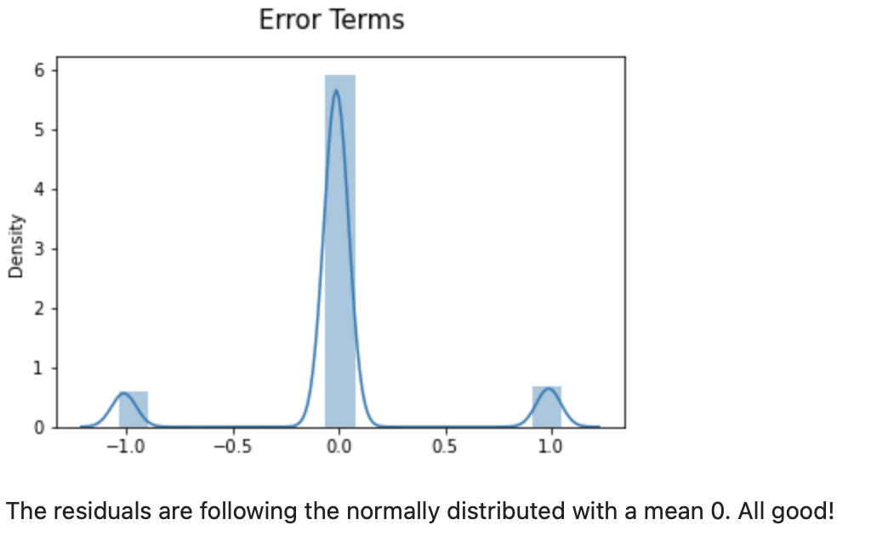
The residuals are following the normally distributed with a mean 0. All good!
Root Mean Square Error=0.999
Model Summary
We can say that as there is an increase in the Cost, we are seeing good profits. Which means that whatever strategy that is being used for sales is clearly working good

Slide 10
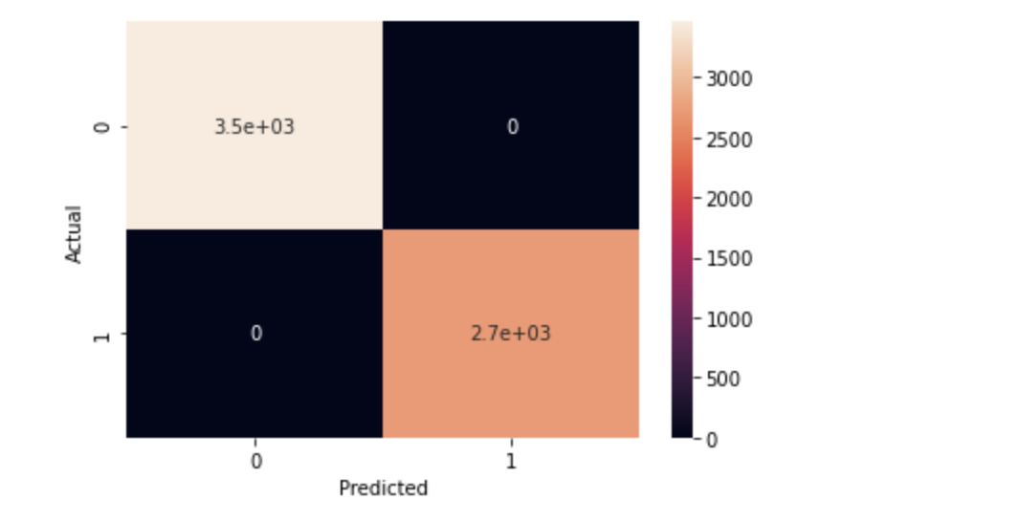
II: Logistic Regression
Model Accuracy is 1.0.
There are only TP and FP. Accuracy of this logistic regression model is 100% meaning that profit_satisfied category completely depends on ['Revenue','Planned Revenue','Product Cost’]
Great model!

Slide 11
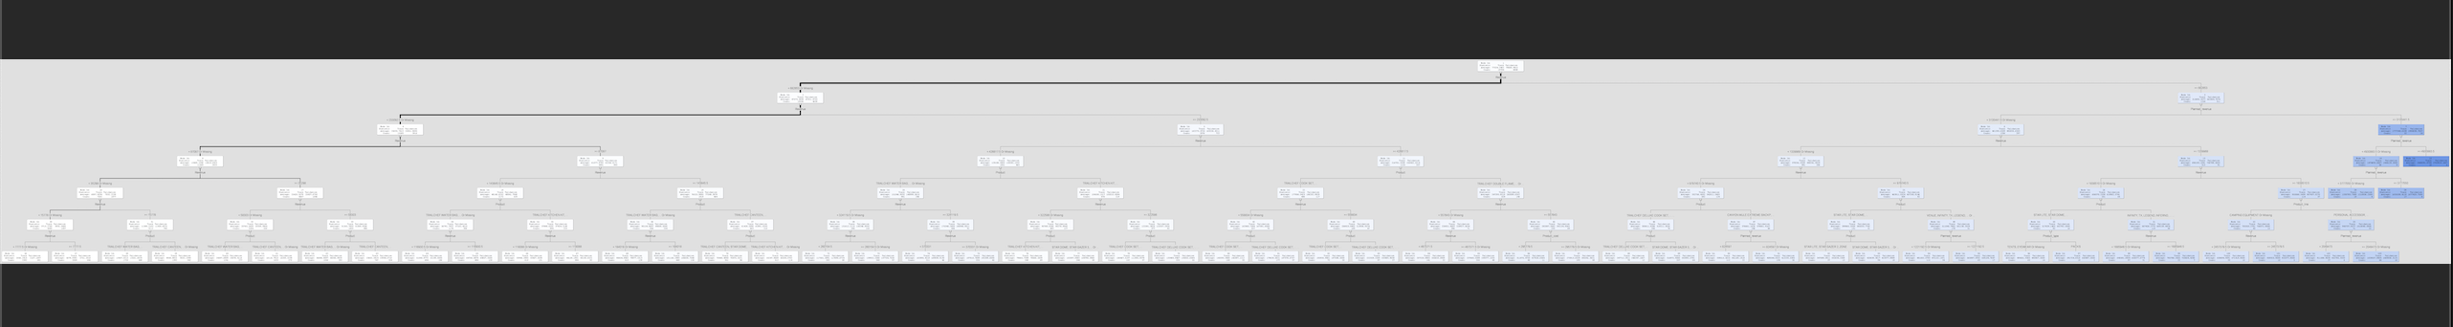
III: Decision Trees

Slide 12
SUMMARY/ RECOMMENDATIONS AND CONCLUSIONS
CHOOSING THE BEST MODEL
Linear regression is the best model
WHAT BUSINESS DECISION SHOULD BE MADE ON THE ANALYSIS
Sales is going as expected
As investment is increasing, we would be having great yield across all products and countries
RECOMMENDATIONS:
After detailed analysis we can say that the sales of outdoor products world wide is growing with the increase in the investments and some of the shortcomings of this analysis are
Too many missing values
More features on the data like customer related info, months, day, seasonality information
If we can gather these details, we can expand our analysis to different dimensions

